Slide 1
Week 11 Cash control
Introduction to concept of Cash control
Simple Bank Reconciliation
Intro to Cash budgets

Slide 2
1 Cash control
Control of cash receipts is VIP
Control measures inc
Cash received should be recorded promptly
Only authorised people can handle cash
Cash should be banked asap and in a safe manner
A petty cash system should be in place for small cash amounts
Segregation of duties – person receiving and handling the cash is not the person recording the cash
Rotation of staff roles will assist detection of errors or theft
Bank reconciliation statement should be prepared on a regular basis

Slide 3
2 Specific cash control measures p432
Cash register forces recording of cash reciepts and generates the cash receipt docket
Use of scanners automates the process and avoids keyboard errors
Customers can check transactions as they are processed
Daily totals from Cash register can be checked against the cash in the till (less the float)

Slide 4
3 Other cash control
Issue a receipt and keep a copy
Cash through the mail should be checked by 2 people
Check the cheques for errors
EFT need to be checked online or from the Bank Statement
Petty cash book for small amounts of cash

Slide 5
4 Banking cash receipts
Common sense practices ..
like vary banking times, and route,
rotate duties,
keep a copy of the stamped receipt ….

Slide 6
Cash payments
Remittance advice and cheques and other documentation should be forwarded to 2 signatories
EFT procedures

Slide 7
5 Bank Reconciliation
Documents for cash receipts
CRR, receipts,
Documents for Cash Payments: Cheque butt
Cash at Bank Account: shows the cash position at the end of each month
We also need to record Bank Statement information
Interest, bank fees, direct deposits, EFTPOS, direct payments, Government debit tax ……..

Slide 8
Bank Statement
The Bank prepares a Statement on a regular basis (monthly) for the business
The Bank Statement records all transactions with the Bank but from the Bank’s view …..
Increases in cash (cash& chq deposits, EFTPOS, direct credits) are recorded as a credit in the Bank statement (BS)
Decreases in cash (chq, direct debit, charges) are recorded as a Debit

Slide 9
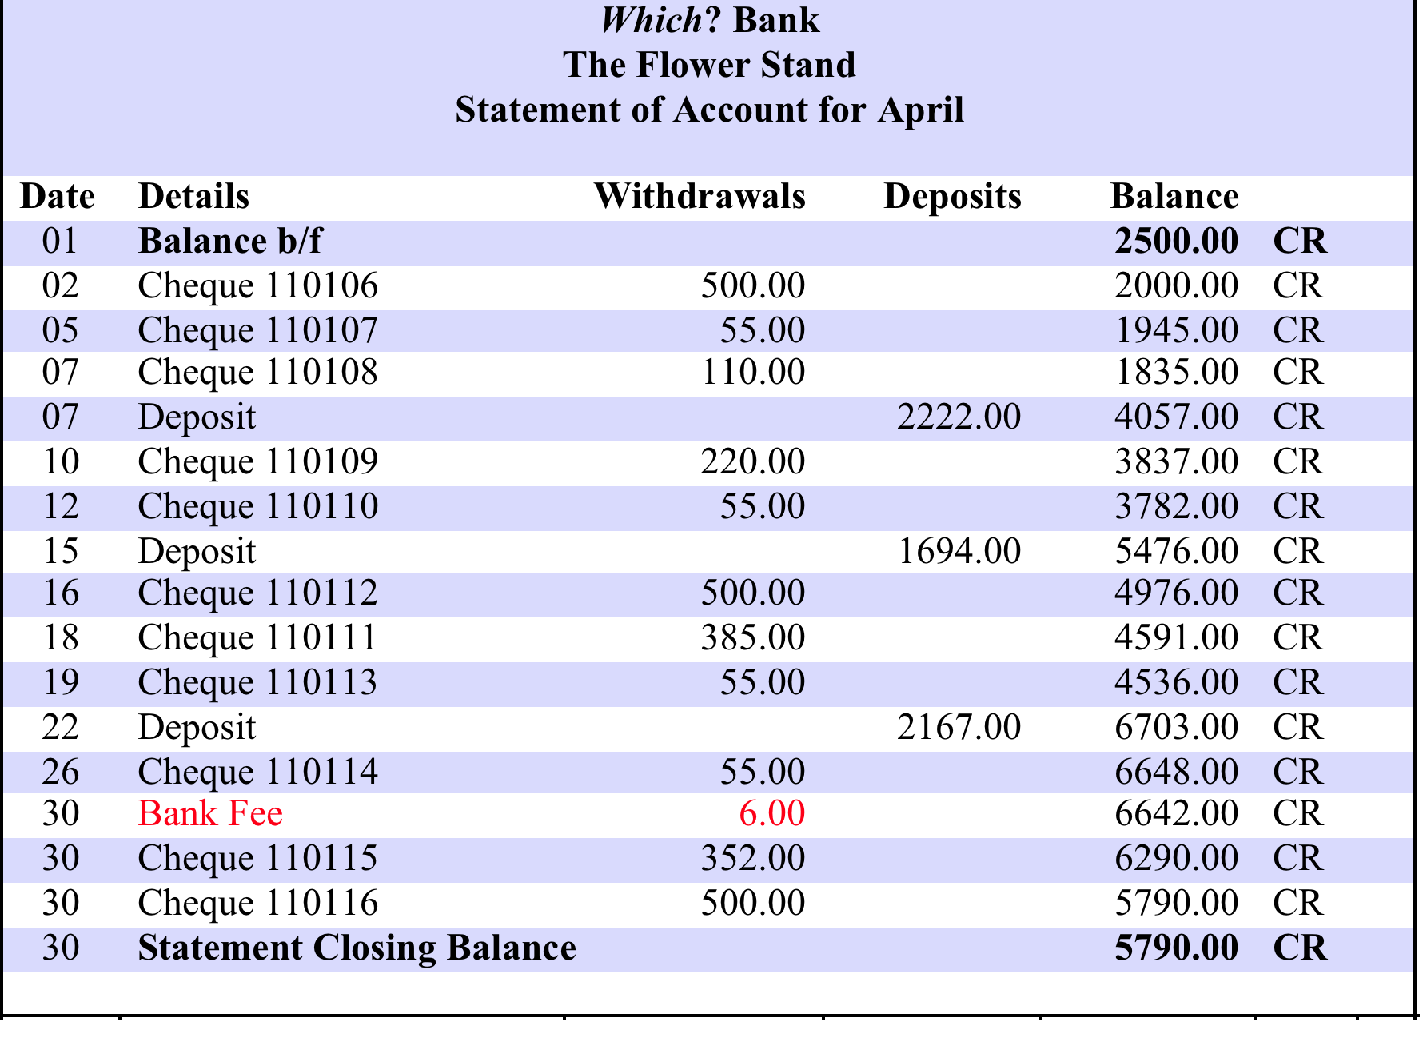
Example of Bank statement

Slide 10
7 Reconciling transactions recorded by the bank
There can be many transactions that are conducted directly to and from our Bank Account with the bank.
Deposits
EFTPOS
Credit card sales
Commission
Interest earned
Payments
Bank fees
Interest paid to the bank
Direct payment etc….

Slide 11
8 Reconciling transactions recorded by the bank
We must check the Bank’s records with our Cash Journals records to detect any variations
Tick ✓ items common to both
Note the items that are only in one of – Bank Statement or CRJ,CPJ
We can’t change the Bank’s records but we CAN adjust our own cash journals records
We must add to OUR CRJ and CPJ any unticked items in the Bank Statement

Slide 12
Bank Reconciliation Process
We need to explain why:
the balance from the Bank Statement
is different to
the balance in the Cash at Bank a/c .

Slide 13
Fix any errors in the Cash journals eg we may type in $4000 for cash sales and it should be $400 so we adjust at the end of the month Cash sales (3600)

Slide 14
Returned Cheques
Dishonored cheque $200, appears in the withdrawals column in the Bank statement to offset the recording on the deposit column.
Look for RTD (Return to Drawer) This is the Bank’s code in the Bank statement.
In the Cash Receipts Journal we must offset the original deposit by recording the deposit as a negative ($200) by using brackets.

Slide 15
Other cash journal adjustments
Errors
Dishonored cheques

Slide 16
Bank Reconciliation process
Tick ✓and forget items that appear in both CRJ, CPJ and Bank Statement.
Any Unticked items in the Bank Statement CAN be included in the CRJ, CPJ. Items such as Interest, Direct payments, Bank fees….
Tick✓ and forget as they appear in both documents.
Any unticked items still in the CRJ, CPJ must then be included in the Bank Reconciliation Statement like so……

Slide 17
Bank Reconciliation Statement as at 31 August
Bank Statement Credit Balance $2000
PLUS Outstanding Deposits $500
$2500
LESS Unpresented Cheques
Ch No 0034 $700
= Debit Balance from Bank a/c $1800

Slide 18
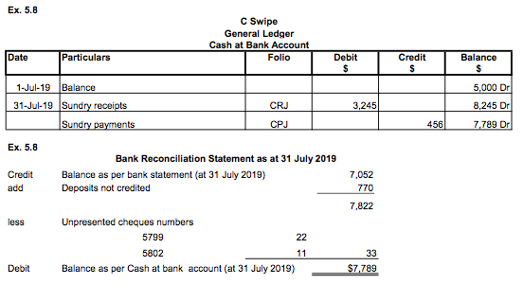

Slide 19
What about a negative bank balance
A debit balance in the Bank Statement means you owe the Bank – you are in the Red.
Bank Reconciliation Statement
as at the 30 April 2009
Debit Balance from Bank Statement (3000 )
PLUS Outstanding deposit 500
(2500)
LESS Unpresented cheques
ch no 000876 700
Credit Balance in Cash at Bank a/c (3200)

Slide 20
What about brought forward balance from previous month and Bank Rec from previous month?
Tick ✓and forget items that appear in both Cash Journals
Compared to
last month’s Reconciliation Statement
&
Bank Statement.
Add Unticked items from the Bank Statement to Cash Journals. (Items such as Interest, Direct payments, Bank fees)
Any unticked items in the Cash Journals and last months Bank Rec Statement are included in this month’s Bank Reconciliation Statement.

Slide 21
TASK 9 JJ is owner of Heating business. Received a Bank Statement showing a balance of $400. His own records in the Cash at Bank ledger account show only $75 balance. He noted 2 differences: A deposit of $80 on 31 July does not appear in the Bank Statement 2 cheques written on 26/7 are missing. They are chq no 4561 for $180 and 4562 for $225 Prepare a Bank Reconciliation statement at 31/7/2018
Heater Installations: Bank reconciliation statement as at 31 July 2018
Balance as per bank statement |  |  |  | x | CR
plus | Deposits not yet credited |  |  | x
less | Unpresented cheques
 | Chq. No. |  | Amount
 | x |  | x
 | x |  | x
Balance as per cash records of business

Slide 22
10 Bank Reconciliation Task
The cash journals shown below were prepared for Lappin Glaziers for the month of March 2018. On 1 March the business had $2400 in the bank.
Compare the Bank statement and the Cash Journals (simplified) and update the cash journals if required.
Calculate the cash at bank balance in the ledger at 31/3
Prepare Bank Reconciliation as at 31/3
See Workbook for details

Slide 23
11 Cash Budget
To put simply, we are interested in knowing how much cash we have at the end of the budgeted period.
Probably one of the more practical budgets you will do! Some people may have even done one inadvertently!
The cash budget shows expected cash receipts and payments, and how they affect the business’ cash balance.
This helps the entrepreneur anticipate cash shortages, or cash excesses that could be better used for profitable projects or investments.

Slide 24
Cash Budget
Components of Cash Budget:
Cash balance at start
+ Cash Receips
equals Cash Available
- Cash Payments
equals Estimated cash balance at end

Slide 25
Cash Budget
Opening Balance: $15,000
Cash Receipts:
Cash Collection $13,500
Other $ 1,500
Total Cash Available: $30,000
Cash Payments:
Purchases ($9,500)
Direct Labour ($1,000)
Selling and Admin. Expenses ($500)
Total Payments: ($11,000)
Ending Balance: $19,000

Slide 26
Schedule of Cash Collection
Quite often a business might not actually collect all the cash at the point of sale.
e.g. think about Harvey Norman and their business model “60 Months Interest Free – No Deposit, No Interest, with Monthly Payments”
When this occurs there is a mismatch in timing between sales and cash collected.
This is where we can utilize a Schedule of Cash Collection
A Schedule of Cash Collection simply lays out when each dollar of sales will be ‘collected’.

Slide 27
12 Schedule of Cash Collection
Example: Suppose we estimate that sales for Jan, Feb and Mar were $20,000, $35,000 and $40,000 respectively. On average we collect 50% of the sales in month of sale, 40% in the next month and 10% two months after the sale.
 | Jan | Feb | Mar
Jan (Sales $20,000) | $20,000 * 0.50 =$10,000 | $20,000 * 0.40 =$8,000 | $20,000 * 0.10 =$2,000
Feb (Sales $35,000) |  | $35,000 * 0.50 =$17,500 | $35,000 * 0.40 = $14,000
Mar (Sales $40,000) |  |  | $40,000 * 0.50 =$20,000
Total Cash Collected | $10,000 | $17,500 + $8,000 =$25,500 | =$2000+$14000+$20000 =$36,000

Slide 28
Schedule of Cash Payments
When you operate a business and purchase goods from suppliers, you often wouldn’t pay for the goods up front.
e.g. you’re supplier may deliver goods to you 2-3 times per week but you may have negotiate to pay them once a month.
Again when this occurs there’s a mismatch between the purchase of goods and cash payments.
To remedy this we can use a Schedule of Cash Payments.
Very similar to a Schedule of Cash Collection but in the reverse.

Slide 29
Schedule of Cash Payments
Example: Suppose we estimate that our purchases for Jan, Feb and Mar were $5,000, $10,000 and $12,000 respectively. On average we pay for 50% of in the same month and 50% of purchases a month after.
 | Jan | Feb | Mar
Jan (Purchases $5,000) | $5 000 * 0.50 = $2,500 | $5 000 * 0.50 = $2,500
Feb (Purchases $10,000) |  | $10 000 * 0.50 = $5,000 | $10 000 * 0.50 = $5,000
Mar (Purchases $12,000) |  |  | $12 000 * 0.50 = $6,000
Total Cash Payment | $2,500 | $7,500 | $11,000

